Slide 1
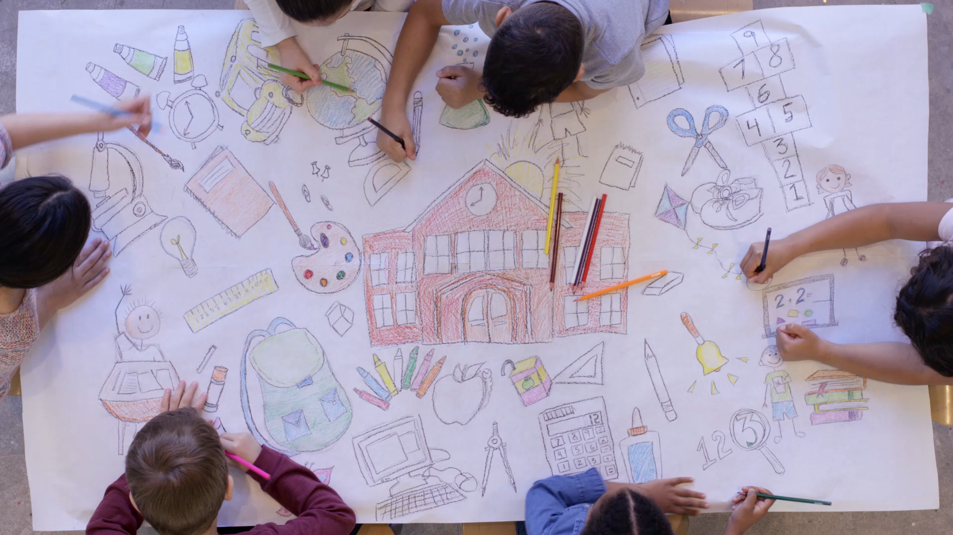
Parents’ school
Szabó Gabriella
2021. 11.24.

Slide 2
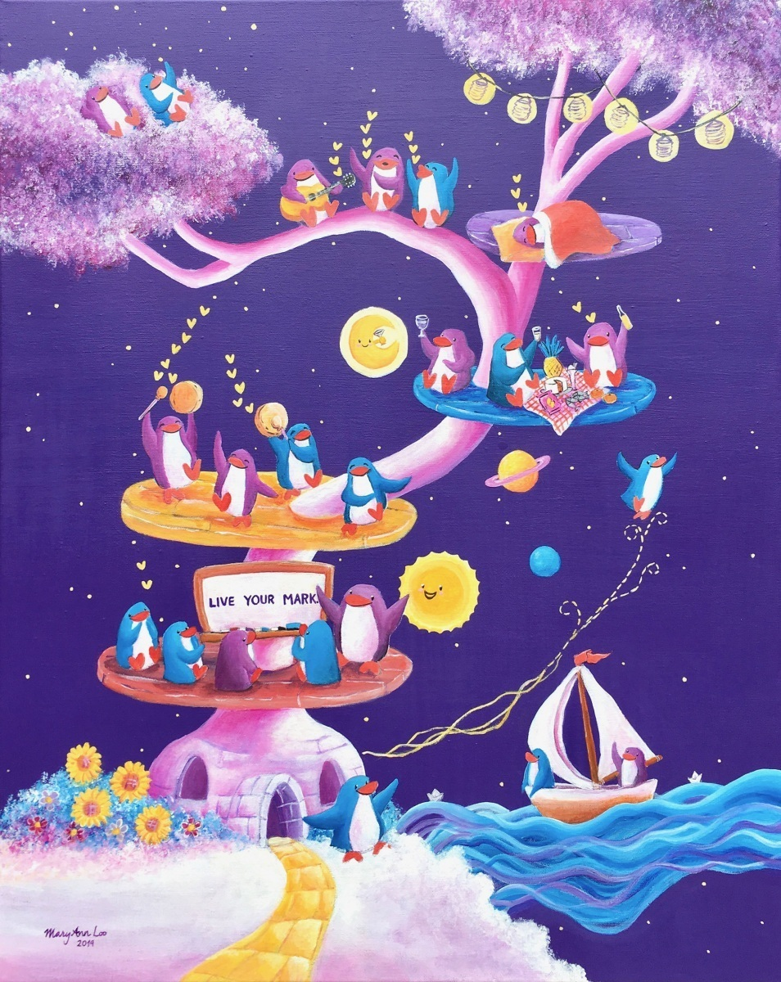
SCHOOL
OF
LIFE

Slide 3


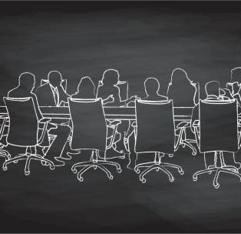
ALL IN ONE

Slide 4

BECAUSE YOU’RE WORTH IT.

Slide 5

GOOD ENOUGH?

Slide 6


D I Y

Slide 7


HOLIDAY
VACATION
PROMOTION
PAY RAISE

Slide 8



ON DUTY

Slide 9

TWO BOSSES
OR MORE

Slide 10

HUMAN BEING

Slide 11
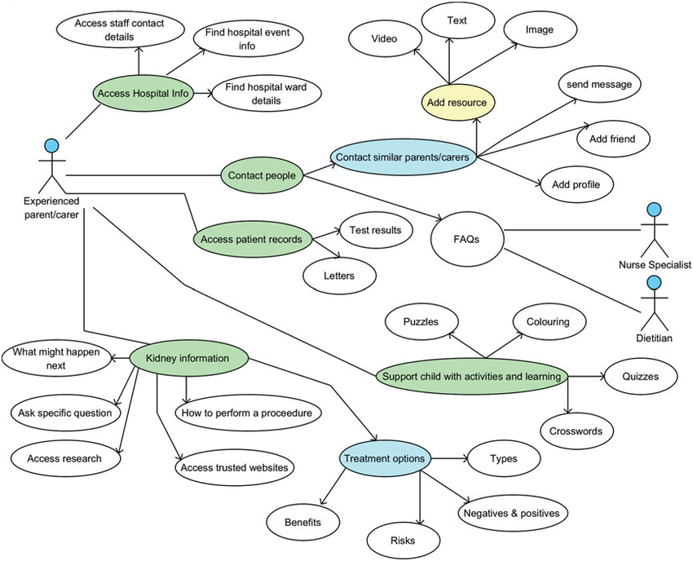

COMPLEXITY:

Slide 12
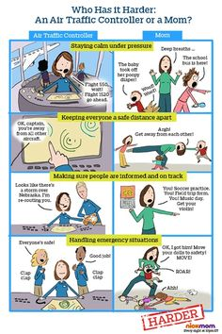

Slide 13
There are parents who…
BREAK DOWN BARRIERS
PAVE THE WAY
BREAK OPEN THE DOORS AND INVADE THE TERRITORY
BARRICADE US, DIGGING DITCHES, AND DRAWING WALLS
IGNORE THE MELODY AND JUST PAY ATTENTION TO FALSE VOICES
REMAIN STRANGERS SPEAKING AN UNKNOWN LANGUAGE
WHICH ONE IS YOU?

Slide 14
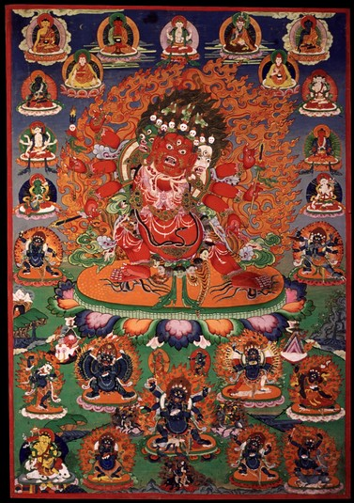
BEING
OF
MANY FACES

Slide 15
NANÁ!

